Slide 1
Functions

Slide 2
Learning Objectives
Modular Programming
Defining and Calling Functions
Function Prototypes
Sending Data into a Function
Passing Data by Value
Using Functions in a Menu-Driven Program
The return Statement
Returning a Value from a Function
Returning a Boolean Value
Local and Global Variables
Static Local Variables
Default Arguments
Using Reference Variables as Parameters
Overloading Functions
The exit() Function
Stubs and Drivers

Slide 3
Modular Programming (1 of 2)
Modular programming: breaking a program up into smaller, manageable functions or modules
Function: a collection of statements that perform a specific task
Functions are commonly used to break a problem down into small, manageable pieces
Instead of writing one long function that contains all of the statements necessary to solve a problem, several small functions that each solve a specific part of the problem can be written.
This approach is sometimes called divide and conquer
Motivation for modular programming:
Improves maintainability of programs
Simplifies the process of writing programs
Code reuse: writing the code to perform a task once, then reusing it each time you need to perform the task.

Slide 4
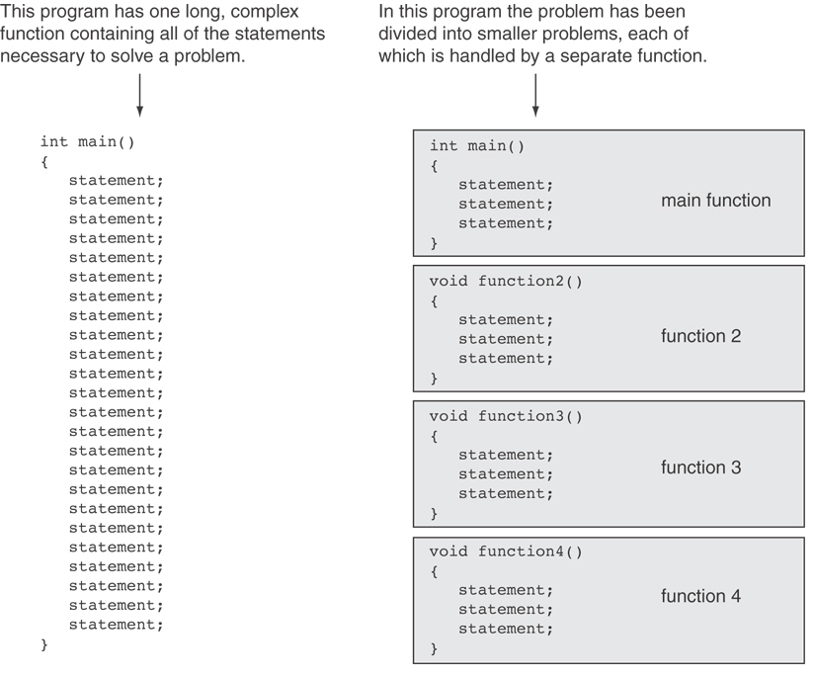
Modular Programming (2 of 2)

Slide 5
Defining and Calling Functions
Function call: A function call is a statement that causes a function to execute
Function definition: collection of statements that make up a function

Slide 6
Function Definition (1 of 2)
Function Definition includes:
return type: data type of the value that function returns to the part of the program that called it
name: name of the function. Function names follow same rules as variables
parameter list: list of variables that hold the values passed to the function
body: The body of a function is the set of statements that perform the function’s task. These statements are enclosed in {}.

Slide 7
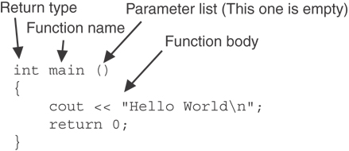
Function Definition (2 of 2)
The following figure shows the definition of a simple function with the various parts labeled.
Note: The line that reads int main()is called the function header.

Slide 8
Function Return Type
If a function returns a value, the type of the value must be indicated:
int main()
The main function in all of the programs we have seen is declared to return an int value to the operating system. The return 0; statement causes the value 0 to be returned when the main function finishes executing.
It is not necessary for all functions to return a value. Some functions simply perform one or more statements, and then terminate. These functions are called void functions.
If a function does not return a value, its return type is void:
void printHeading()
{
cout << "Monthly Sales\n";
}

Slide 9
Calling a Function
To call a function, use the function name followed by () and ;
printHeading();
The function’s name is printHeading. This name gives an indication of what the function does: It displays a heading.
Developer should always give functions names that reflect their purpose.
Notice the function’s return type is void. This means the function does not return a value to the part of the program that executed it.
Also notice the function has no return statement.
When called, program executes the body of the called function
After the function terminates, execution resumes in the calling function at point of call.

Slide 10
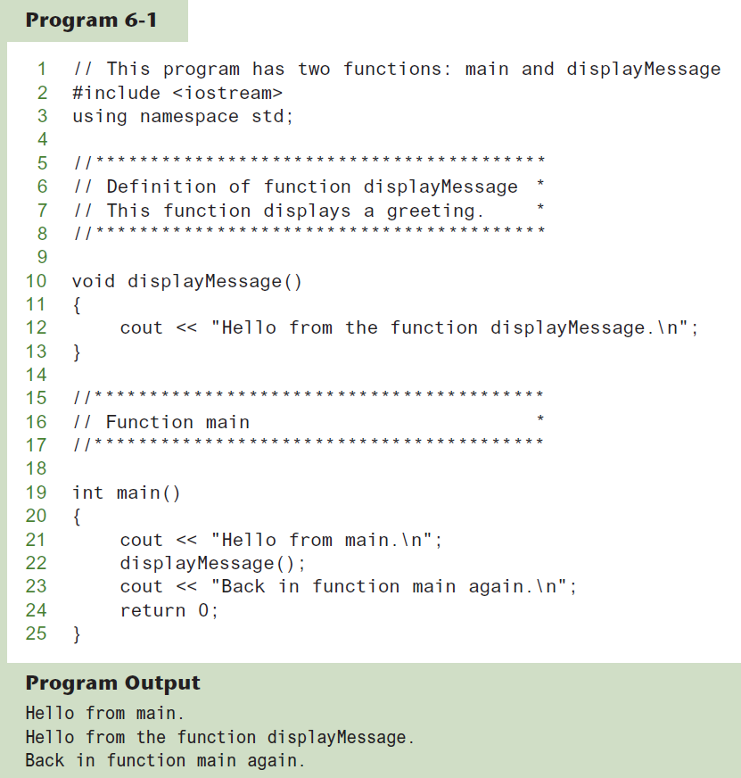
Functions in Program 6-1

Slide 11
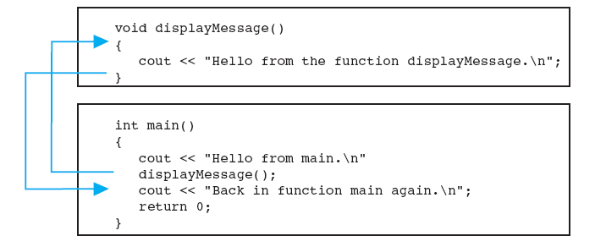
Flow of Control in the Program
A function is executed when it is called. Function main is called automatically when a program starts, but all other functions must be executed by function call statements.
When a function is called, the program branches to that function and executes the statements in its body.

Slide 12
Calling Functions
main can call any number of functions
Functions can call other functions
Compiler must know the following about a function before it is called:
function name
function return type
number of parameters
data type of each parameter
The function call is a statement that executes the function, so it is terminated with a semicolon like all other C++ statements.
The return type is not listed in the function call, and, if the program is not passing data into the function, the parentheses are left empty.

Slide 13
Function Prototypes
Before the compiler encounters a call to a particular function, it must already know the function’s return type, the number of parameters it uses, and the type of each parameter.
A function prototype is a way to notify the compiler about a function before a call to the function.
A function prototype eliminates the need to place a function definition before all calls to the function.
Otherwise place function definition before calling function’s definition
Use a function prototype (function declaration) – like the function definition without the body
Function Prototype: void printHeading();
Function Header: void printHeading()
The function header is part of the function definition. It declares the function’s return type, name, and parameter list.
Function header is not terminated with a semicolon because the definition of the function’s body follows it.

Slide 14
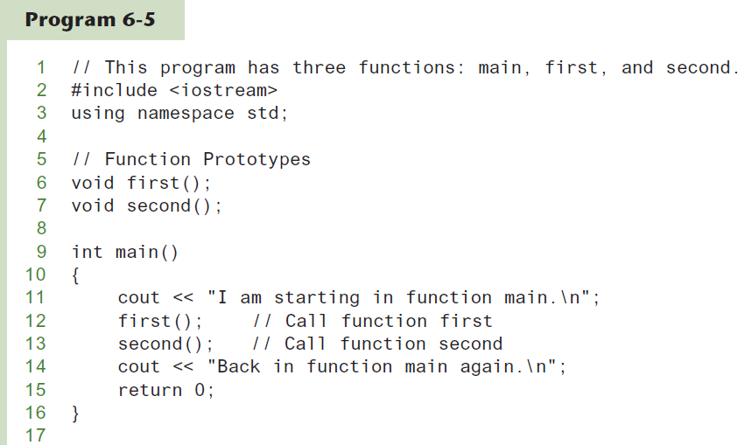
Function Prototypes in Program 6-5 (1 of 2)

Slide 15
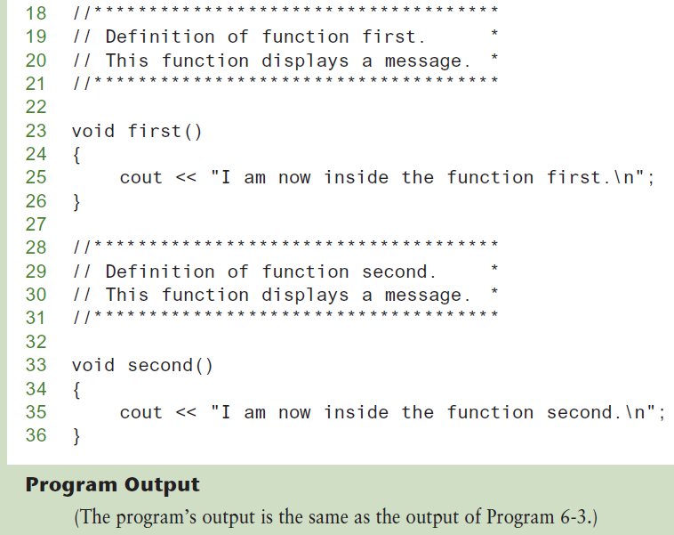
Function Prototypes in Program 6-5 (2 of 2)

Slide 16
Prototype Notes
Place function prototypes near top of program
Program must include either function prototype or full function definition before any call to the function – compiler error otherwise
When using function prototypes, a developer can place function definitions in any order in source file

Slide 17
Sending Data into a Function
When a function is called, the calling function may send values into the called function at the time of function call:
c = pow(a, b);
Values passed to a function are called arguments
Variables in a function header that hold the values passed as arguments are known as parameters

Slide 18
A Function with a Parameter Variable
void displayValue(int num)
{
cout << "The value is " << num << endl;
}
The integer variable num is a parameter.
A parameter receives or accepts any integer value passed to the function.
Data type of parameter must be consistent with the data type of argument

Slide 19
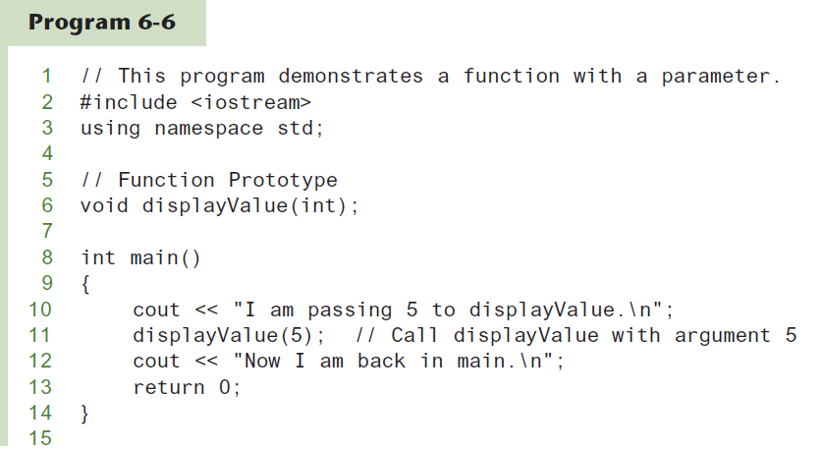
Function with a Parameter

Slide 20
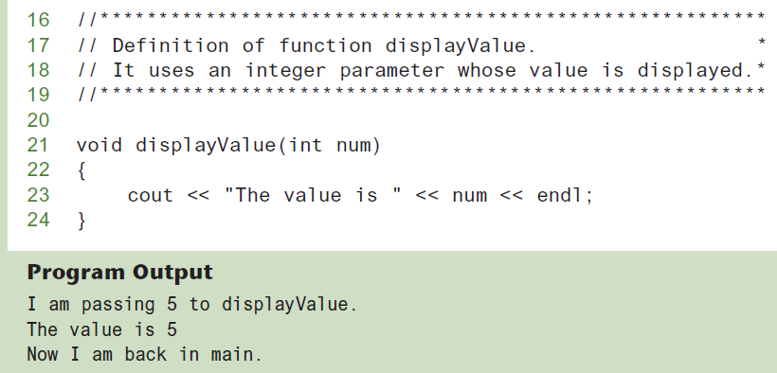
Function with a Parameter in Program 6-6 (1 of 2)

Slide 21
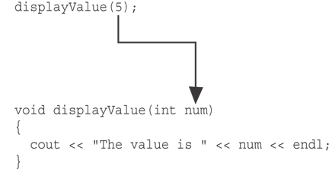
Function with a Parameter in Program 6-6 (2 of 2)
The function call in line 11 passes the value 5 as an argument to the displayValue function.

Slide 22
Other Parameter Terminology
A parameter can also be called a formal parameter or a formal argument
An argument can also be called an actual parameter or an actual argument

Slide 23
Parameters, Prototypes, and Function Headers
For each function argument,
the function prototype must include the data type of each parameter inside its parentheses
the function header must include a declaration for each parameter in its ()
void evenOrOdd(int); //prototype
void evenOrOdd(int num) //header
evenOrOdd(val); //call

Slide 24
Function Call Notes
Value of argument is copied into parameter when the function is called
A parameter’s scope is limited to the body of the function which uses it
Function can have multiple parameters
There must be a data type listed in the prototype () and an argument declaration in the function header () for each parameter
Arguments will be promoted/demoted as necessary to match parameters

Slide 25
Passing Multiple Arguments
When calling a function and passing multiple arguments:
the number of arguments in the function call statement must match the number of parameter in the function prototype and function definition
the first argument will be used to initialize the first parameter, the second argument to initialize the second parameter, etc.

Slide 26
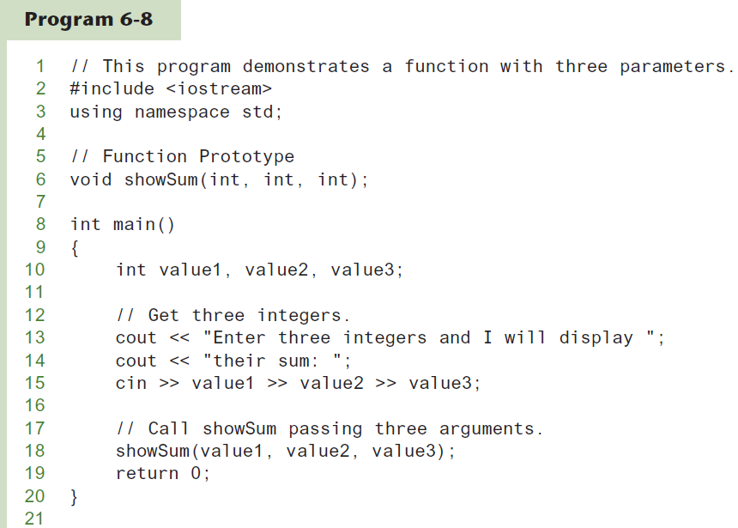
Passing Multiple Arguments in Program 6-8 (1 of 3)

Slide 27
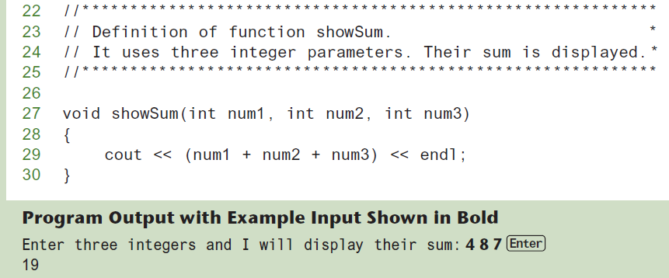
Passing Multiple Arguments in Program 6-8 (2 of 3)

Slide 28
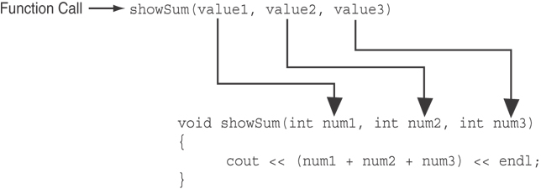
Passing Multiple Arguments in Program 6-8 (3 of 3)
The function call in line 18 passes value1, value2, and value3 as a arguments to the function.

Slide 29
Passing Data by Value
Pass by value: when an argument is passed to a function, its value is copied into the parameter.
Changes to the parameter in the function body do not affect the value of the argument
This is because the function receives a copy of the argument’s value and does not have access to the original argument.
A parameter variable’s storage location in memory is separate from that of the original argument.

Slide 30
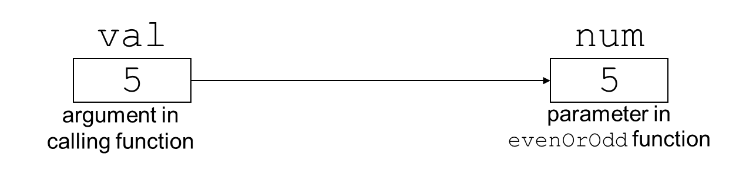
Passing Information to Parameters by Value
Example: int val=5;
evenOrOdd(val);
evenOrOdd can change variable num, but it will have no effect on variable val

Slide 31
Using Functions in Menu-Driven Programs
Functions can be used
to implement user choices from menu
to implement general-purpose tasks:
Higher-level functions can call general-purpose functions, minimizing the total number of functions and speeding program development time
Refer to the Program 6-10 in the book

Slide 32
The return Statement
The return statement is ised to end execution of a function immediately.
Can be placed anywhere in a function
Statements that follow the return statement will not be executed
Can be used to prevent abnormal termination of program
In a void function without a return statement, the function ends at its last statement
the function terminates and the program returns to the statement following the function call statement.

Slide 33
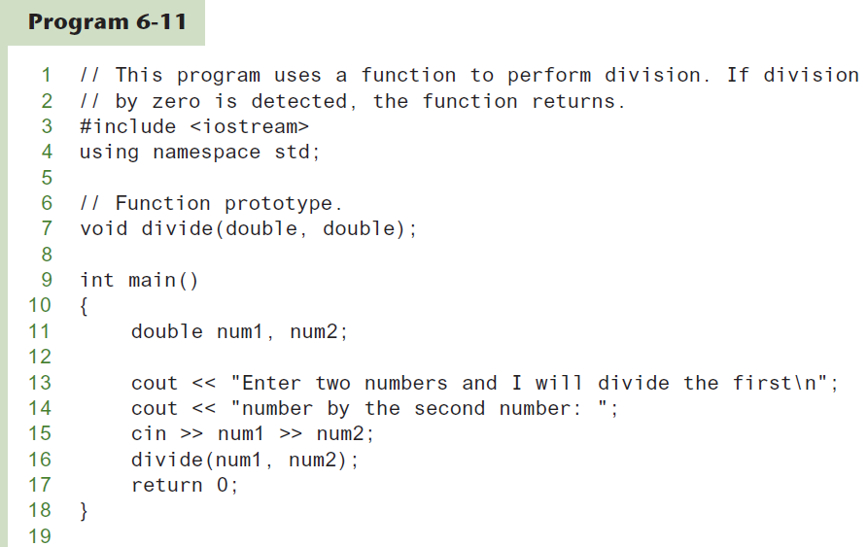
Performing Division in a Program (1 of 2)

Slide 34
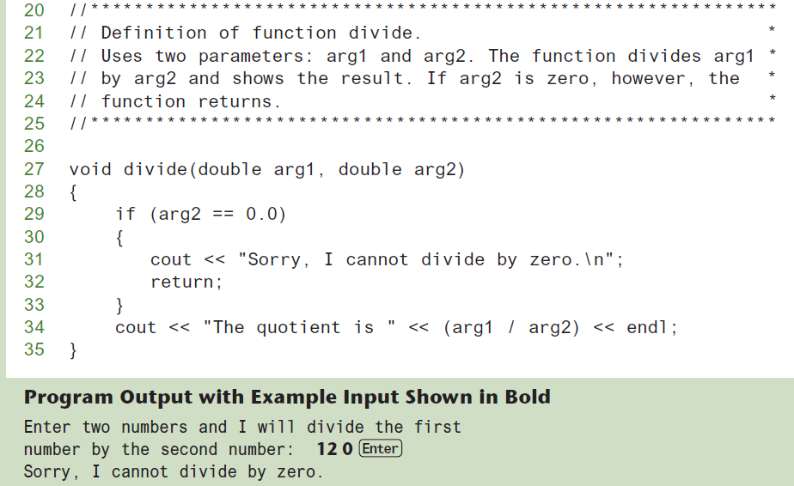
Performing Division in a Program (2 of 2)

Slide 35
Returning a Value From a Function (1 of 2)
A function can return a value back to the statement that called the function.
We have seen that data may be passed into a function by way of parameter variables. Data may also be returned from a function, back to the statement that called it.
Although several arguments may be passed into a function, only one value may be returned from it.
Functions that return a value are appropriately known as value-returning functions.
We have already seen the pow function, which returns a value:
double x; x = pow(2.0, 10.0);

Slide 36
Returning a Value From a Function (2 of 2)
When writing a value-returning function, programmer must decide what type of value the function will return.
Programmer must specify the data type of the return value in the function header and in the function prototype.
A value-returning function will use int, double, bool, or any other valid data type in its header.
Recall that a void function, which does not return a value, uses the key word void as its return type in the function header.
In a value-returning function, the return statement is used to return a value from function to the point of function call. Example:
int sum(int num1, int num2) { double result; result = num1 + num2; return result; }

Slide 37
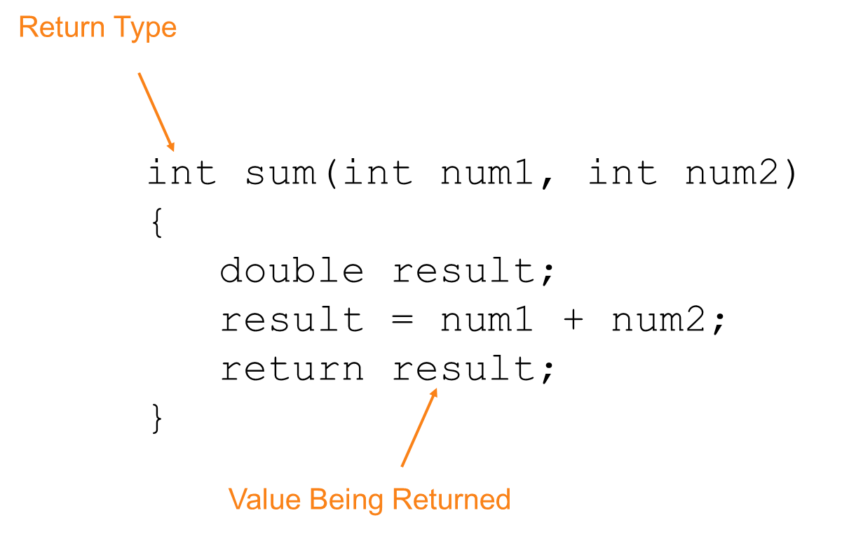
A Value-Returning Function (1 of 2)
Value-returning Function Example:

Slide 38
A Value-Returning Function (2 of 2)
int sum(int num1, int num2) {
return num1 + num2;
}
Functions can return the values of expressions, such as num1 + num2

Slide 39
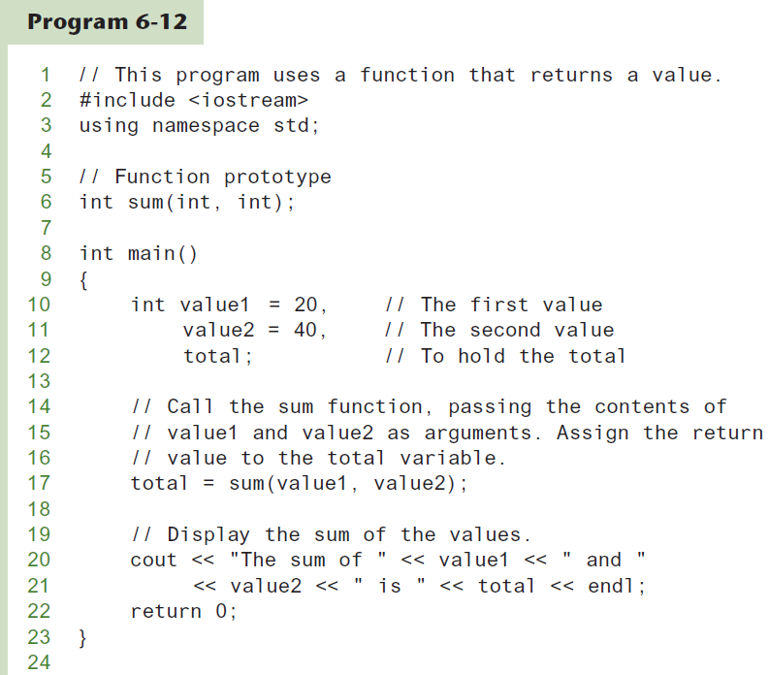
Function Returning a Value in a Program (1 of 3)

Slide 40
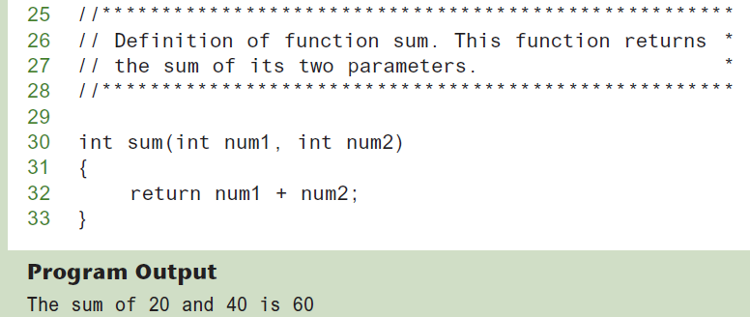
Function Returning a Value in a Program (2 of 3)

Slide 41
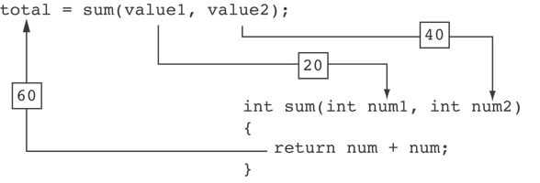
Function Returning a Value in a Program 3 of 3)
The statement in line 17 calls the sum function, passing value1 and value2 as arguments. The return value is assigned to the total variable.

Slide 42
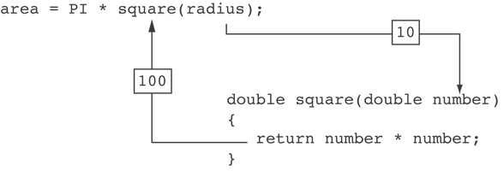
Another Example of value-returning function

Slide 43
Returning a Value From a Function
The prototype and the definition must indicate the data type of return value (not void)
Calling function should use return value:
assign it to a variable
send it to cout
use it in an expression

Slide 44
Returning a Boolean Value
Function can return true or false
Declare return type in function prototype and heading as bool
Function body must contain return statement(s) that return true or false
Calling function can use return value in a relational expression

Slide 45
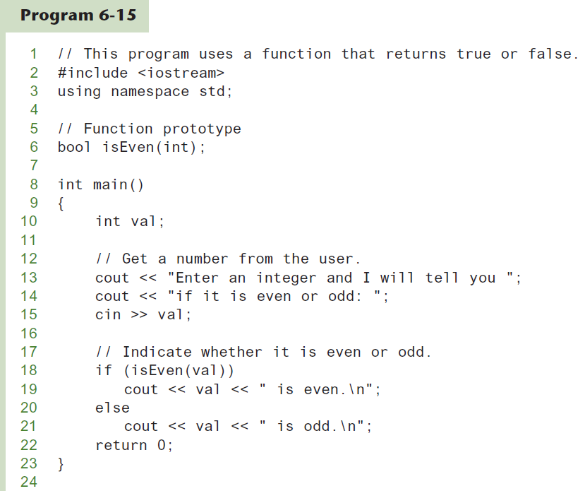
Returning a Boolean Value in a Program (1 of 2)

Slide 46
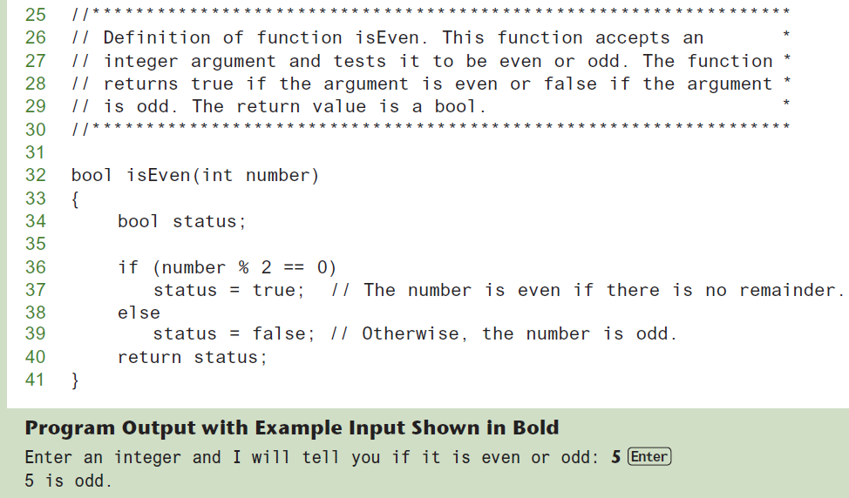
Returning a Boolean Value in a Program (2 of 2)

Slide 47
Local and Global Variables
Variables defined inside a function are local to that function.
Local variables are hidden from the statements in other functions
Local variables are not accessible outside the function.
Because the variables defined in a function are hidden, other functions may have separate, distinct variables with the same name.

Slide 48
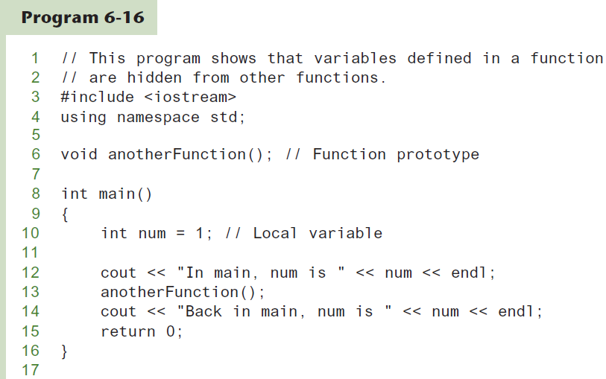
Local Variables in a Program (1 of 3)

Slide 49
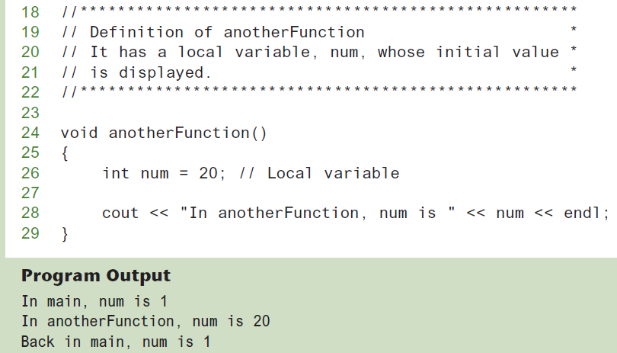
Local Variables in a Program (2 of 3)

Slide 50
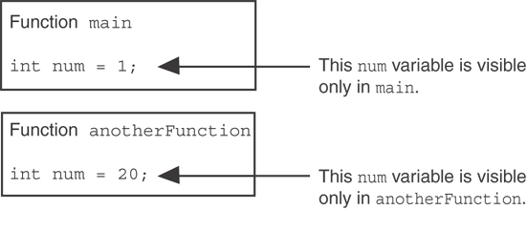
Local Variables in a Program (3 of 3)
When the program is executing in main, the num variable defined in main is visible. When anotherFunction is called, however, only variables defined inside it are visible, so the num variable in main is hidden.

Slide 51
Local Variable Lifetime
A function’s local variables exist only while the function is executing. This is known as the lifetime of a local variable.
When the function begins, its local variables and its parameter variables are created in memory, and when the function ends, the local variables and parameter variables are destroyed.
This means that any value stored in a local variable is lost between calls to the function in which the variable is declared.

Slide 52
Global Variables and Global Constants (1 of 2)
A global variable is any variable defined outside all the functions in a program.
The scope of a global variable is the portion of the program from the variable definition to the end.
This means that a global variable can be accessed by all functions that are defined after the global variable is defined.

Slide 53
Global Variables and Global Constants (2 of 2)
Programmer should avoid using global variables because they make programs difficult to debug.
Any global that a programmer create should be a global constants.

Slide 54
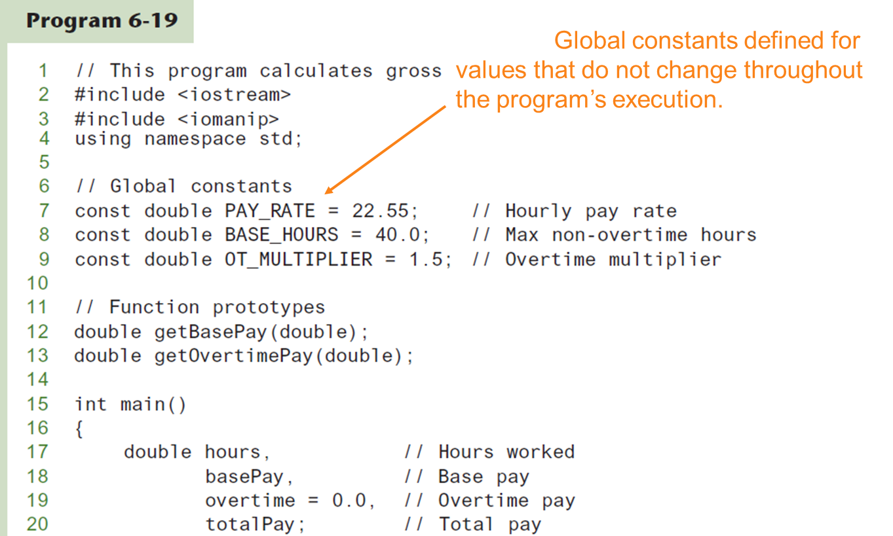
Global Constants in a Program (1 of 2)

Slide 55
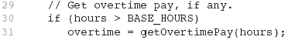
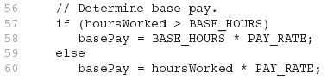
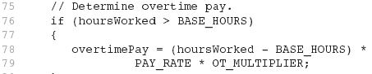
Global Constants in a Program (2 of 2)
The constants are then used for those values throughout the program.

Slide 56
Initializing Local and Global Variables
Local variables are not automatically initialized. They must be initialized by the programmer.
Global variables (not constants) are automatically initialized to 0 (numeric) or NULL (character) when the variable is defined.

Slide 57
Static Local Variables
Local variables only exist while the function is executing. When the function terminates, the contents of local variables are lost.
static local variables retain their contents between function calls.
static local variables are defined and initialized only the first time the function is executed. 0 is the default initialization value.

Slide 58
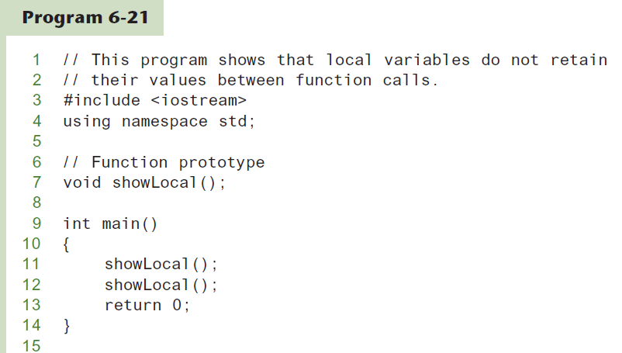
Local Variables Do Not Retain Values Between Function calls in a Program (1 of 2)

Slide 59
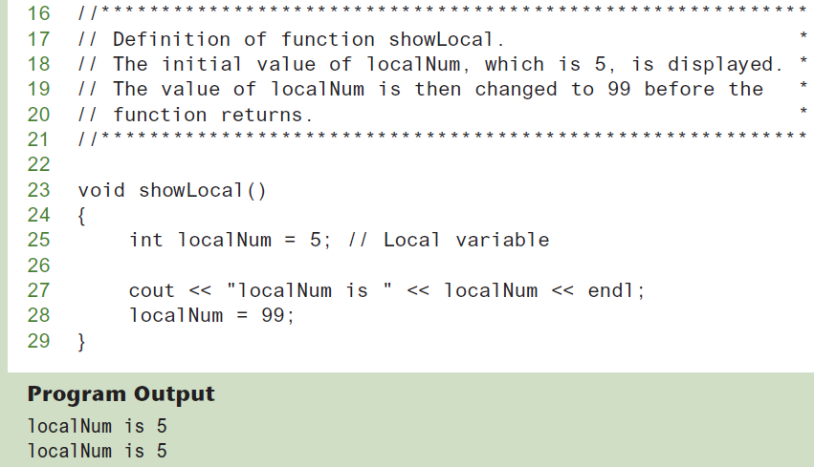
Local Variables Do Not Retain Values Between Function calls in a Program (2 of 2)
In this program, each time showLocal is called, the localNum variable is re-created and initialized with the value 5.

Slide 60
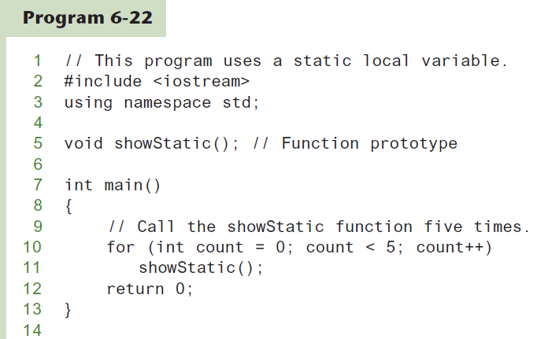
A Different Approach, Using a Static Variable in a Program (1 of 3)

Slide 61
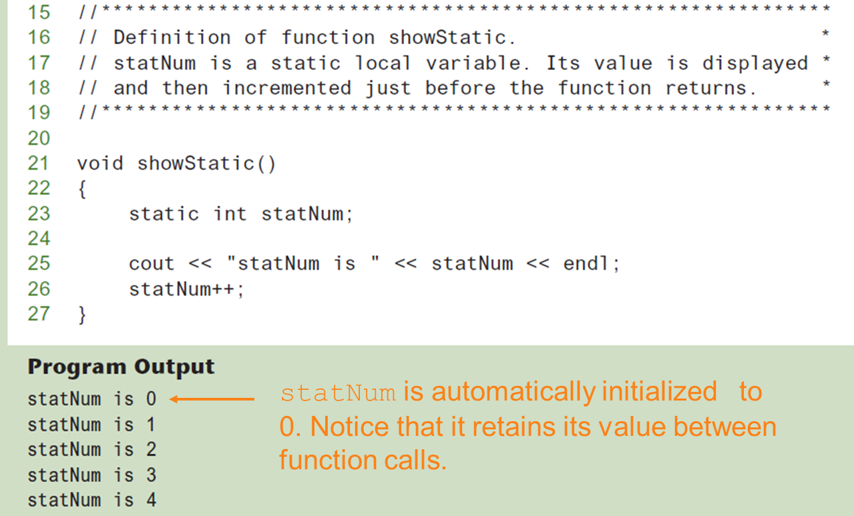
A Different Approach, Using a Static Variable in a Program (2 of 3)

Slide 62
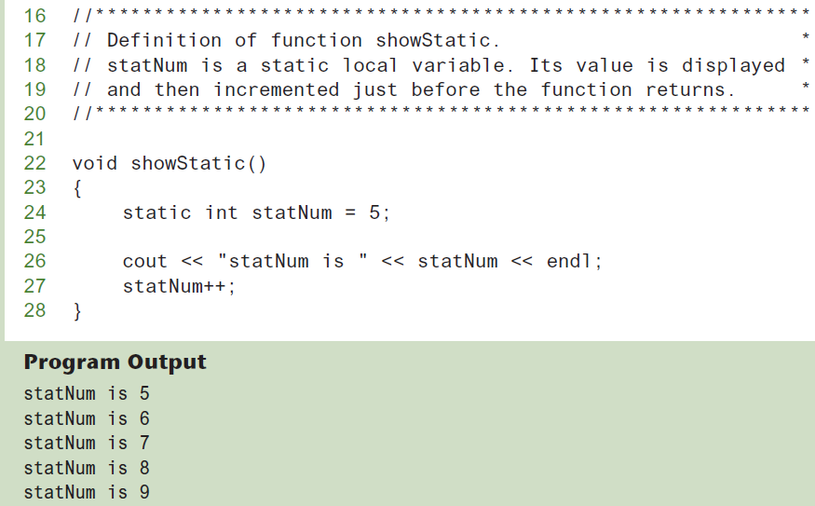
A Different Approach, Using a Static Variable in a Program (3 of 3)
If a local static variable is initialized, the initialization only happens once. See following program example.

Slide 63
Default Arguments (1 of 2)
A Default argument is an argument that is passed automatically to a parameter if the argument is missing on the function call.
Must be a constant declared in prototype:
void evenOrOdd(int = 0);
Can be declared in header if no prototype
Multi-parameter functions may have default arguments for some or all of them:
int getSum(int, int=0, int=0);

Slide 64
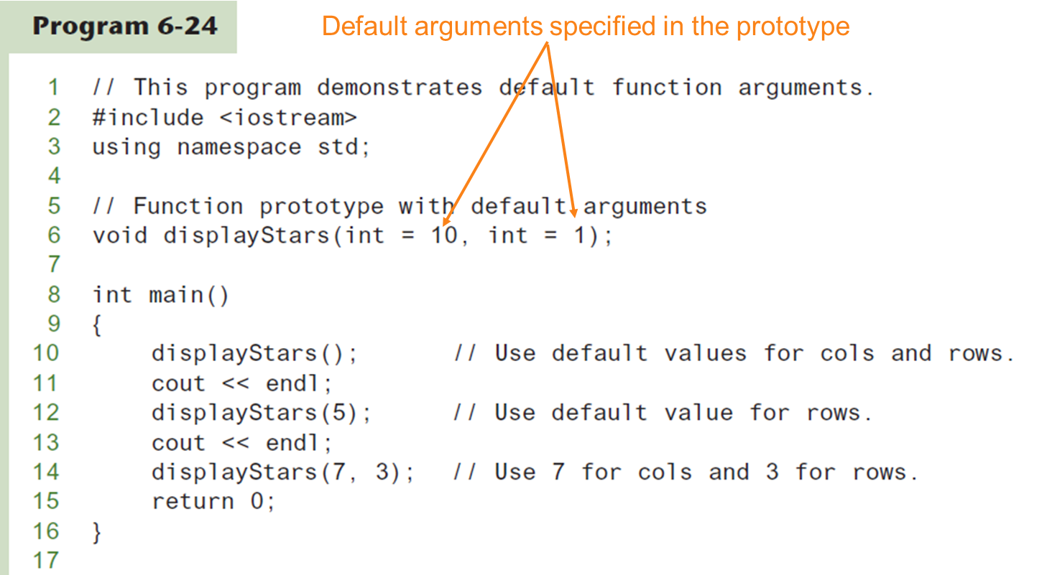
Default Arguments in a Program (1 of 2)

Slide 65
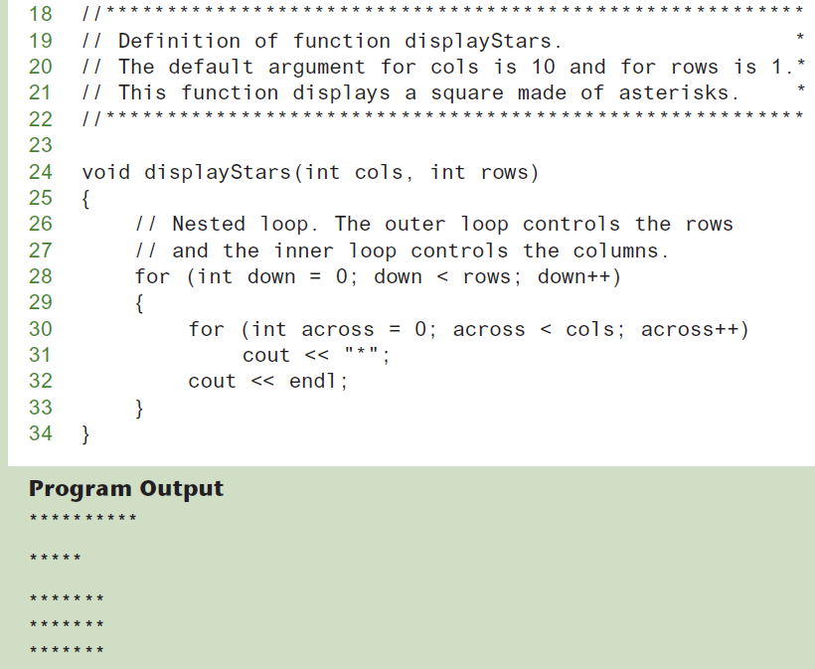
Default Arguments in a Program (2 of 2)

Slide 66
Default Arguments (2 of 2)
If not all parameters to a function have default values, the defaultless ones are declared first in the parameter list:
int getSum(int, int=0, int=0);// OK
int getSum(int, int=0, int); // NO
When an argument is omitted from a function call, all arguments after it must also be omitted:
sum = getSum(num1, num2); // OK
sum = getSum(num1, , num3); // NOT allowed

Slide 67
Using Reference Variables as Parameters
A mechanism that allows a function to work with the original argument from the function call, not a copy of the argument
Allows the function to modify values stored in the calling environment
Provides a way for the function to ‘return’ more than one value

Slide 68
Passing by Reference
A reference variable is an alias for another variable
Defined with an ampersand (&)
void getDimensions(int&, int&);
Changes to a reference variable are made to the variable it refers to
Use reference variables to implement passing parameters by reference

Slide 69
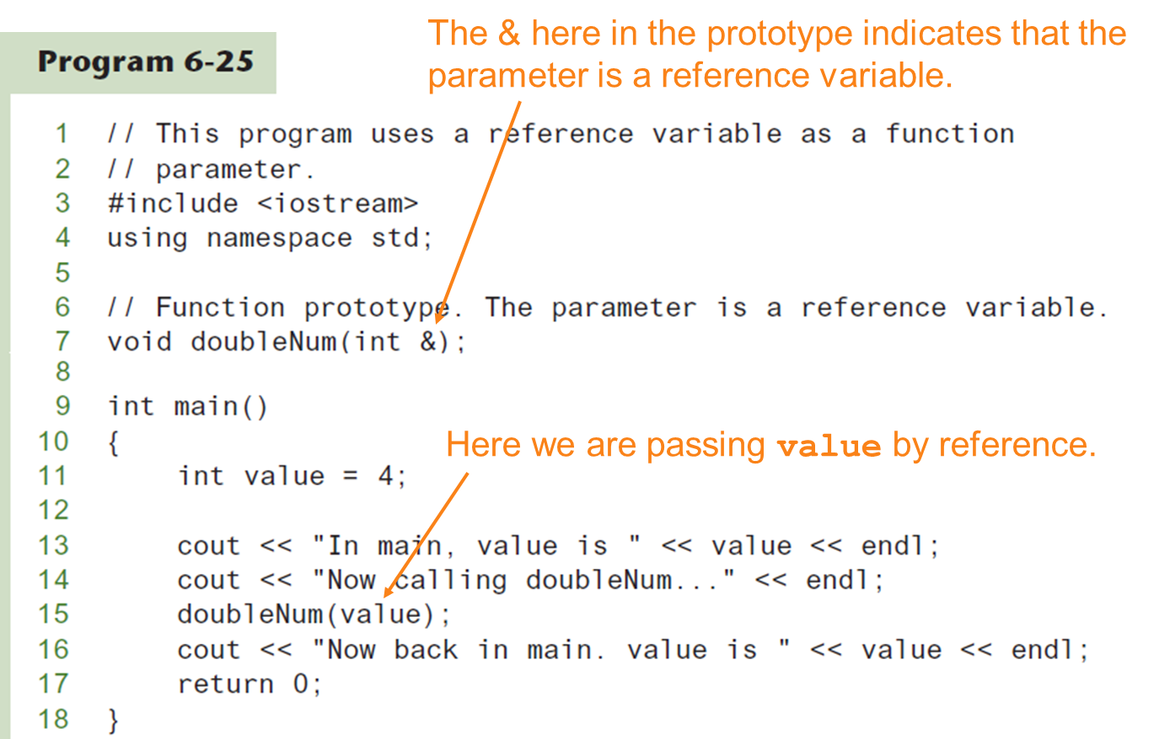
Passing a Variable By Reference

Slide 70
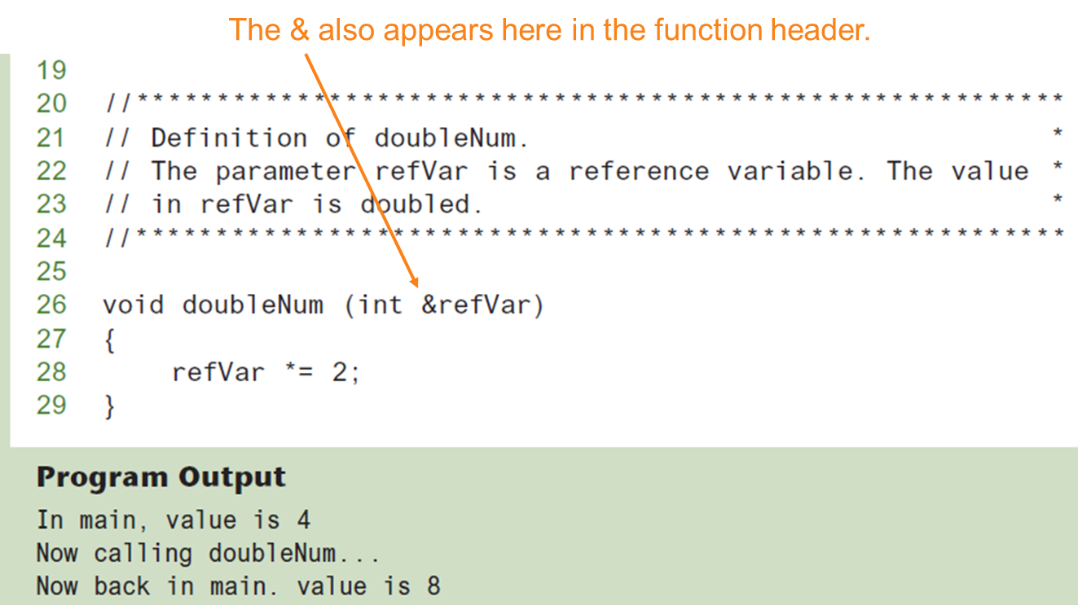
Passing a Variable By Reference

Slide 71
Reference Variable Notes
Each reference parameter must contain &
Space between type and & is unimportant
Must use & in both prototype and header
Argument passed to reference parameter must be a variable – cannot be an expression or constant
Use when appropriate – don’t use when argument should not be changed by function, or if function needs to return only 1 value

Slide 72
Overloading Functions
Overloaded functions have the same name but different parameter lists
Can be used to create functions that perform the same task but take different parameter types or different number of parameters
Compiler will determine which version of function to call by argument and parameter lists

Slide 73
Function Overloading Examples
Using these overloaded functions,
void getDimensions(int); // 1
void getDimensions(int, int); // 2
void getDimensions(int, double); // 3
void getDimensions(double, double);// 4
the compiler will use them as follows:
int length, width;
double base, height;
getDimensions(length); // 1
getDimensions(length, width); // 2
getDimensions(length, height); // 3
getDimensions(height, base); // 4

Slide 74
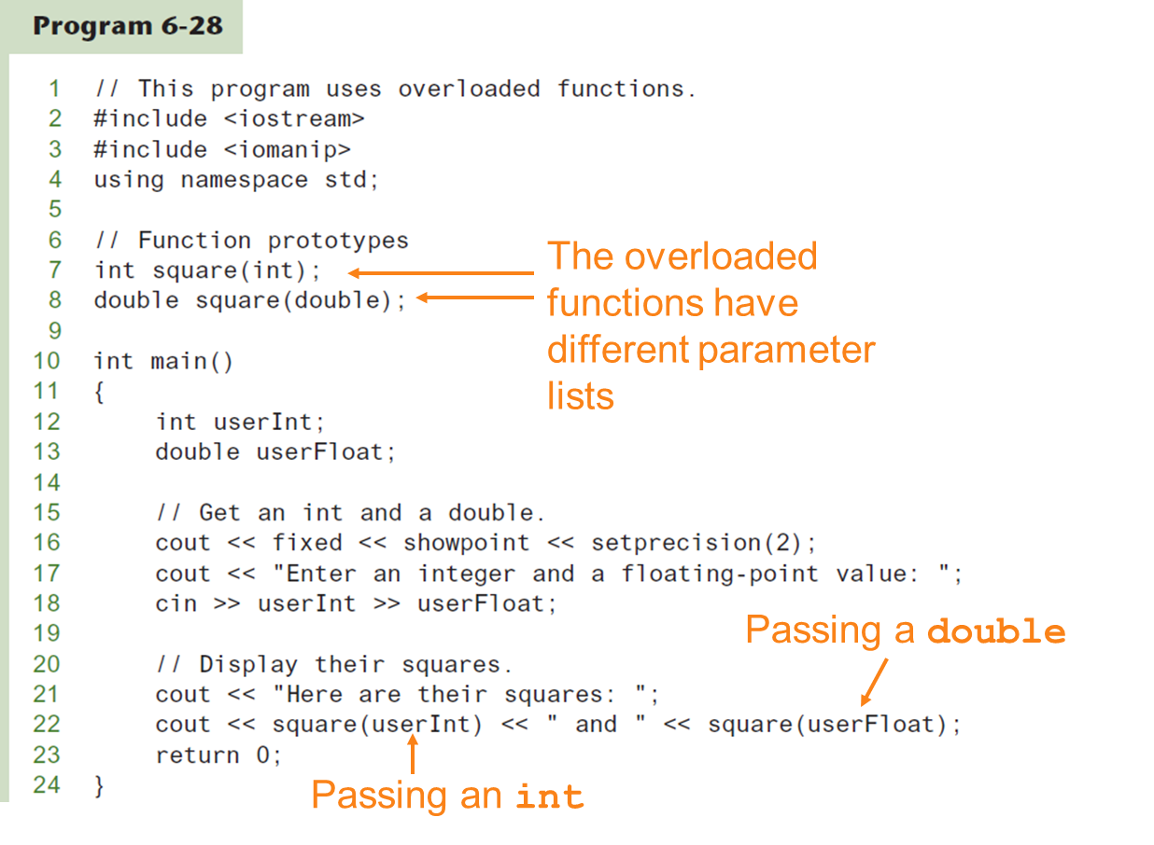
Function Overloading (1 of 2)

Slide 75
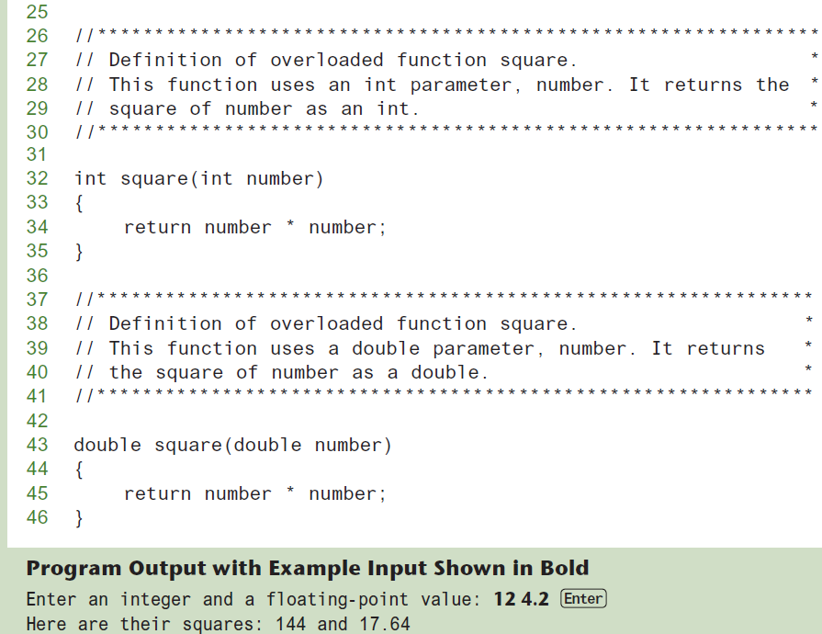
Function Overloading (2 of 2)

Slide 76
The exit() Function (1 of 2)
Terminates the execution of a program
Can be called from any function
Can pass an int value to operating system to indicate status of program termination
Usually used for abnormal termination of program
Requires cstdlib header file

Slide 77
The exit() Function (2 of 2)
Example:
exit(0);
The cstdlib header defines two constants that are commonly passed, to indicate success or failure:
exit(EXIT_SUCCESS); exit(EXIT_FAILURE);

Slide 78
Stubs and Drivers
Useful for testing and debugging program and function logic and design
Stub: A dummy function used in place of an actual function
Usually displays a message indicating it was called. May also display parameters
Driver: A function that tests another function by calling it
Various arguments are passed and return values are tested

